Slide 1
Group 8
Segment 2, Final Project

Slide 2

Question: If having 5 or more skillsets equals higher salary?

Slide 3
Data Source:
The compiled data was found on kaggle but the dataset was scraped from the Glassdoor website using selenium scrapper by Nikhil Bhathi, a nuclear scientist at Nova Scotia.
Weblink: https://www.kaggle.com/nikhilbhathi/data-scientist-salary-us-glassdoor

Slide 4

Data Exploration
Dropping redundant Columns
Changed “Categorical Data” to “Numerical Data” by the means of “pandas.get_dummies”, though “OneHotEncoder” was explored during the proc
Removing rolls with “-1” dataset.

Slide 5
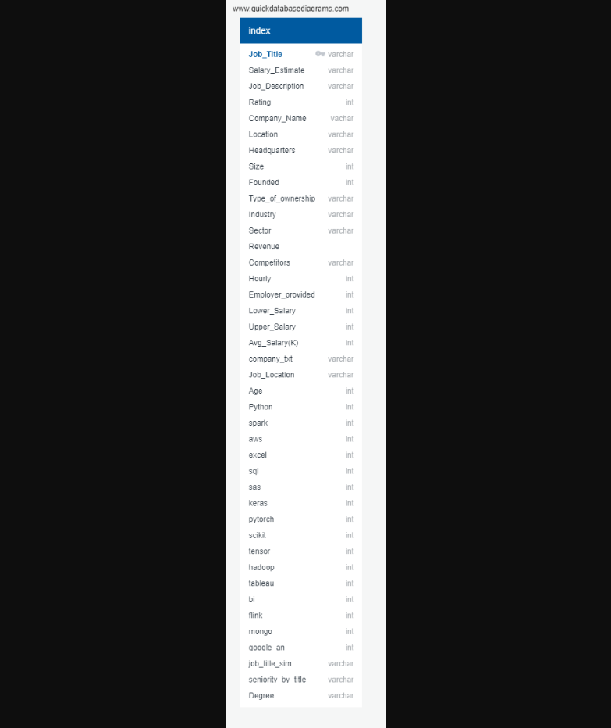
Exploration

Slide 6
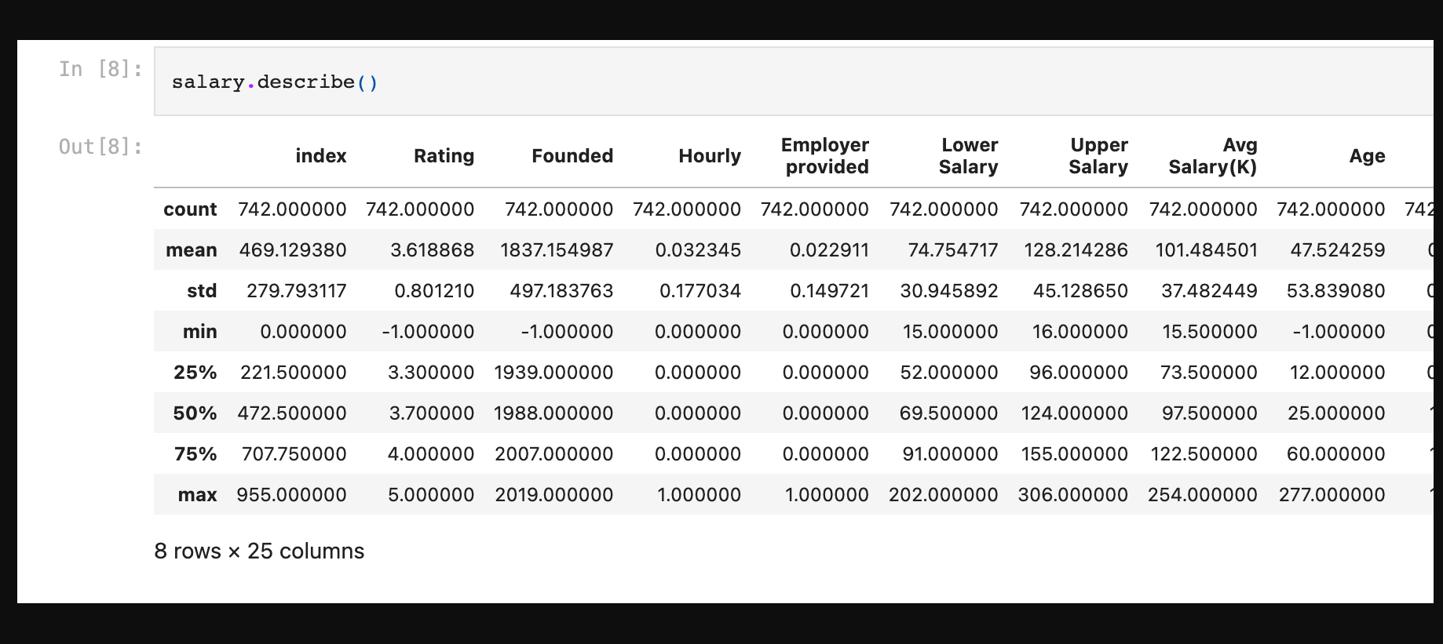
Exploration

Slide 7
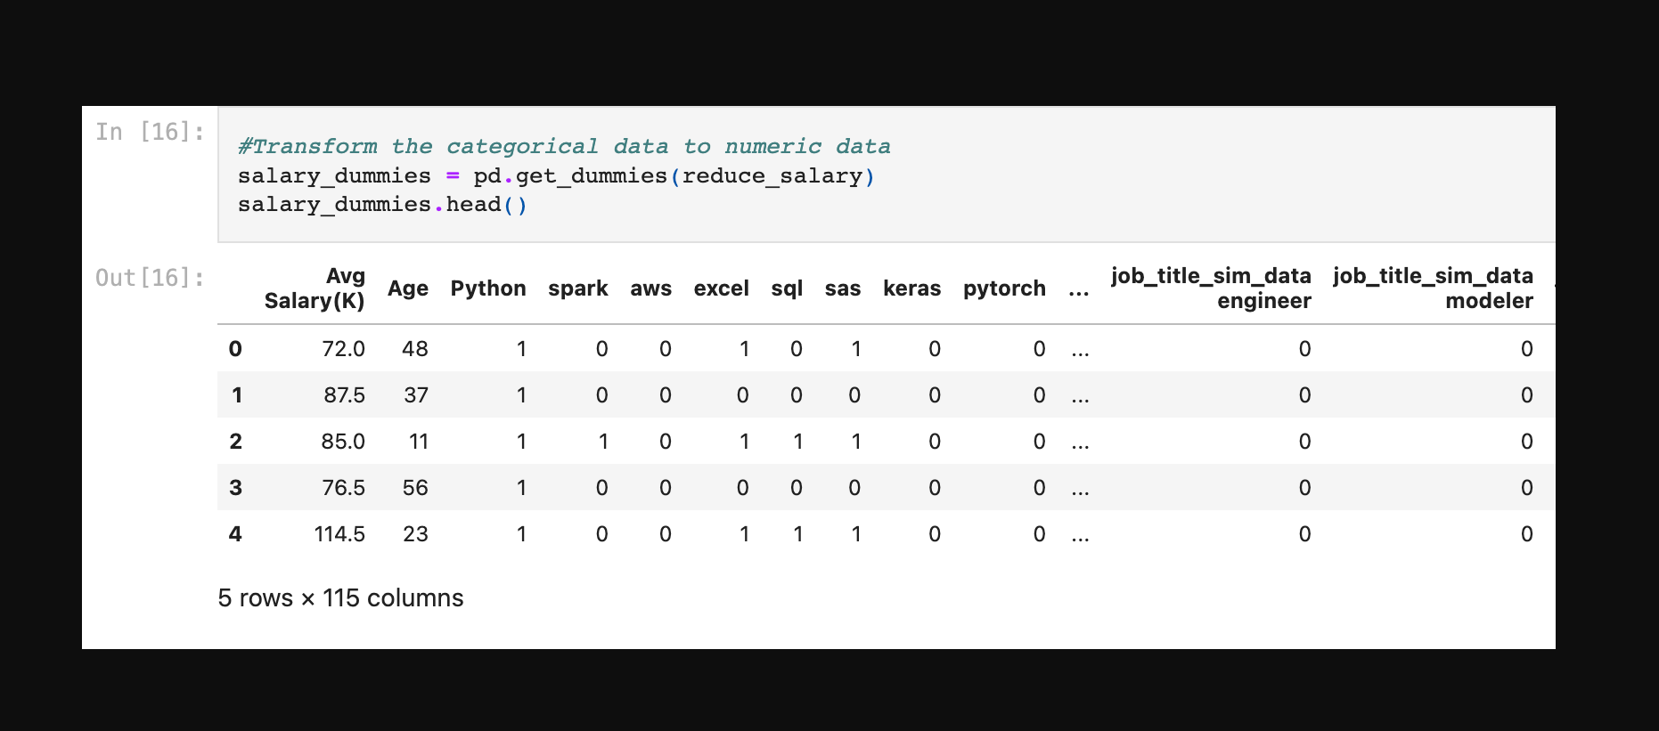
Exploration

Slide 8
Description of the analysis phase of the project.
Separation of the Features(X) from the Target(Y)
Splitting the data into Training & Testing
Creating the model by using LinearRegression and fitting the model to the data
Predicting the test set result and mean squared error
Creating features for Random Forest Regressor
Plotting Features Importances against Relative Imporance
Outlines

Slide 9
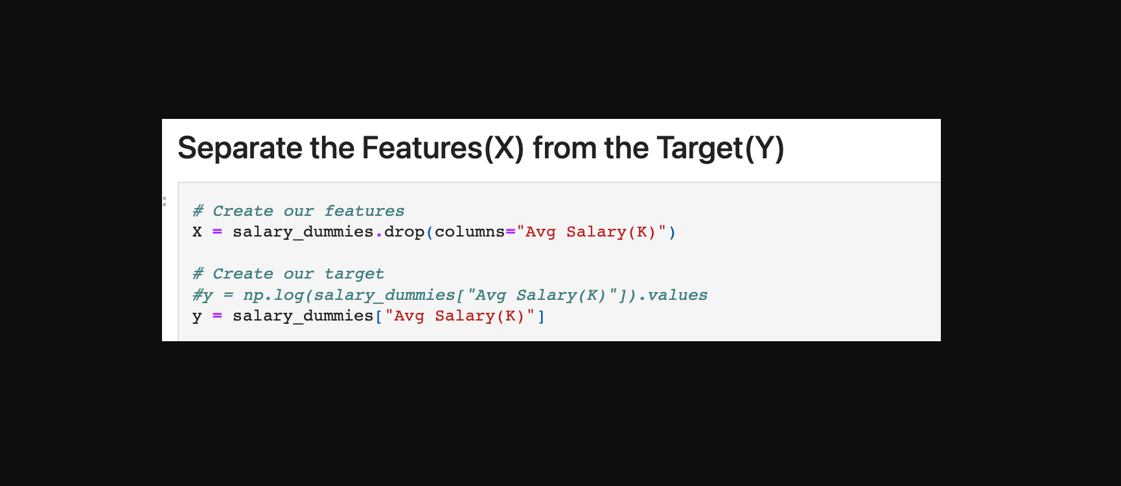
Phase of the project

Slide 10
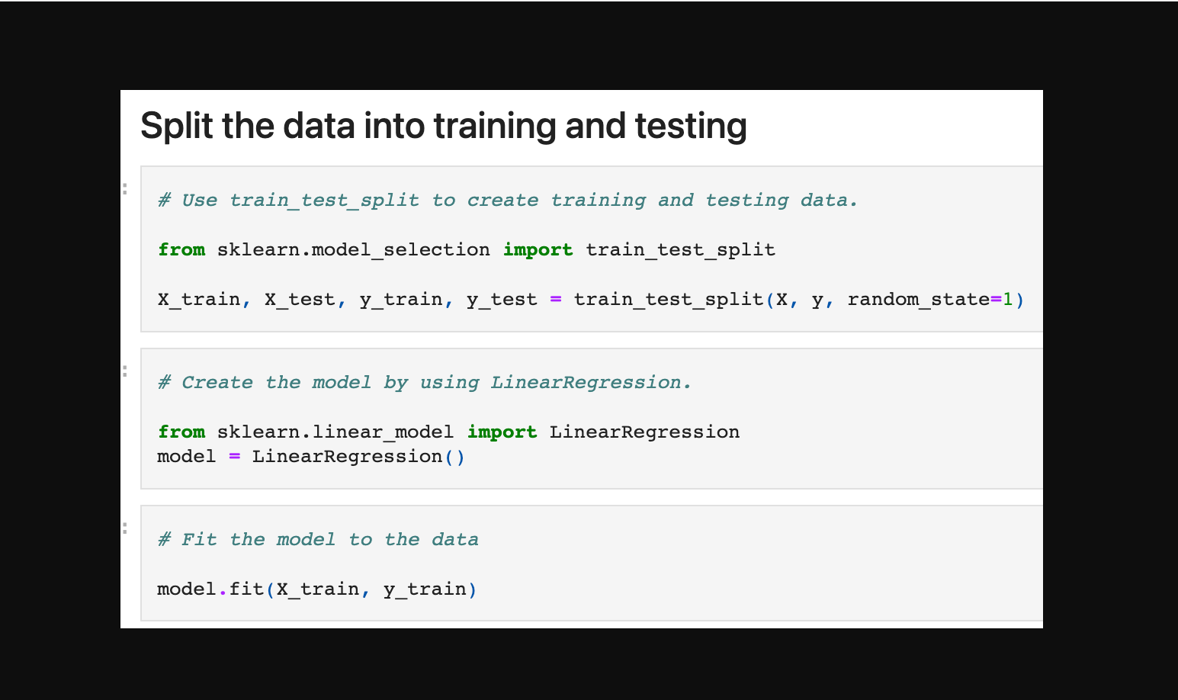
Phase of the project

Slide 11
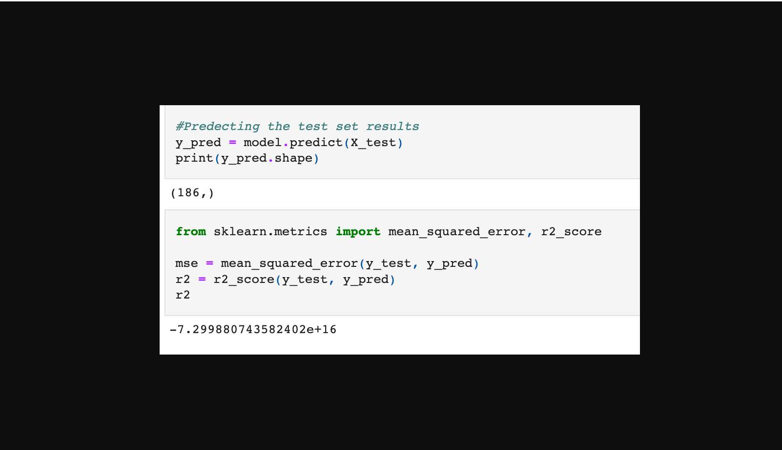
Phase of the project

Slide 12
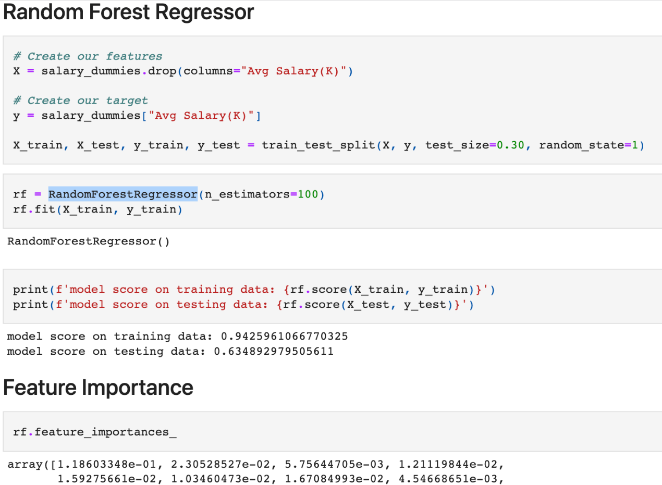
Phase of the project

Slide 13
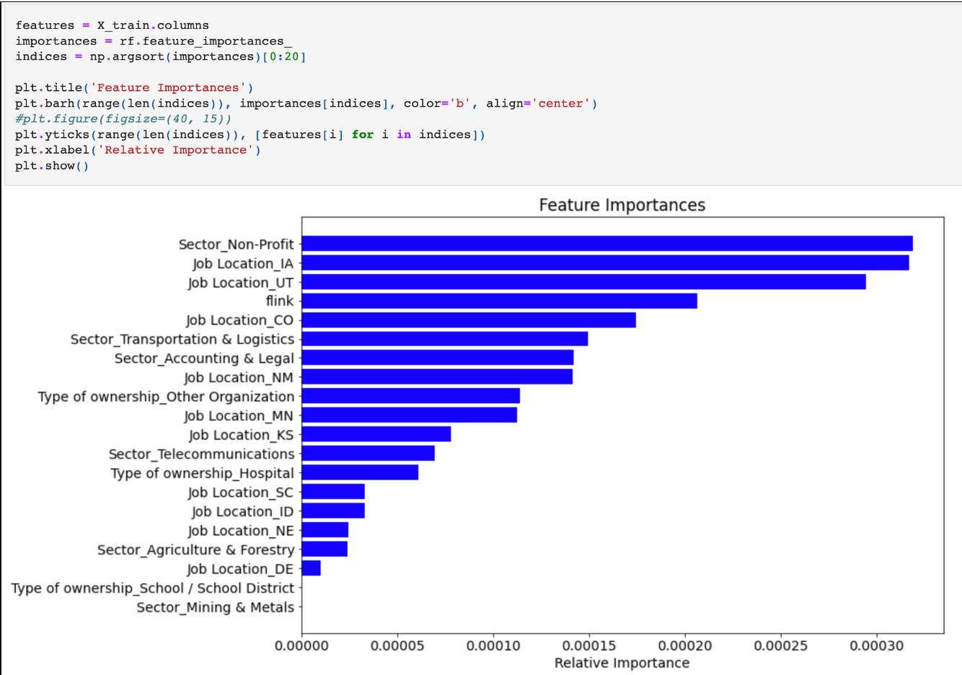
Phase of the project

Slide 14
Group 8
One Team, One Goal.
Bjorn Dennisseur
Funmi Adeboye
Jessica Howard
Rasaq Sule-Odu
Circle
Squarer
Triangle
X

Slide 15
Steps
Step 3
Step 2
Step 1
To be continued
Modeling
Sourcing for data and cleaning of data

